Slide 1
Sales Dashboard

Slide 2
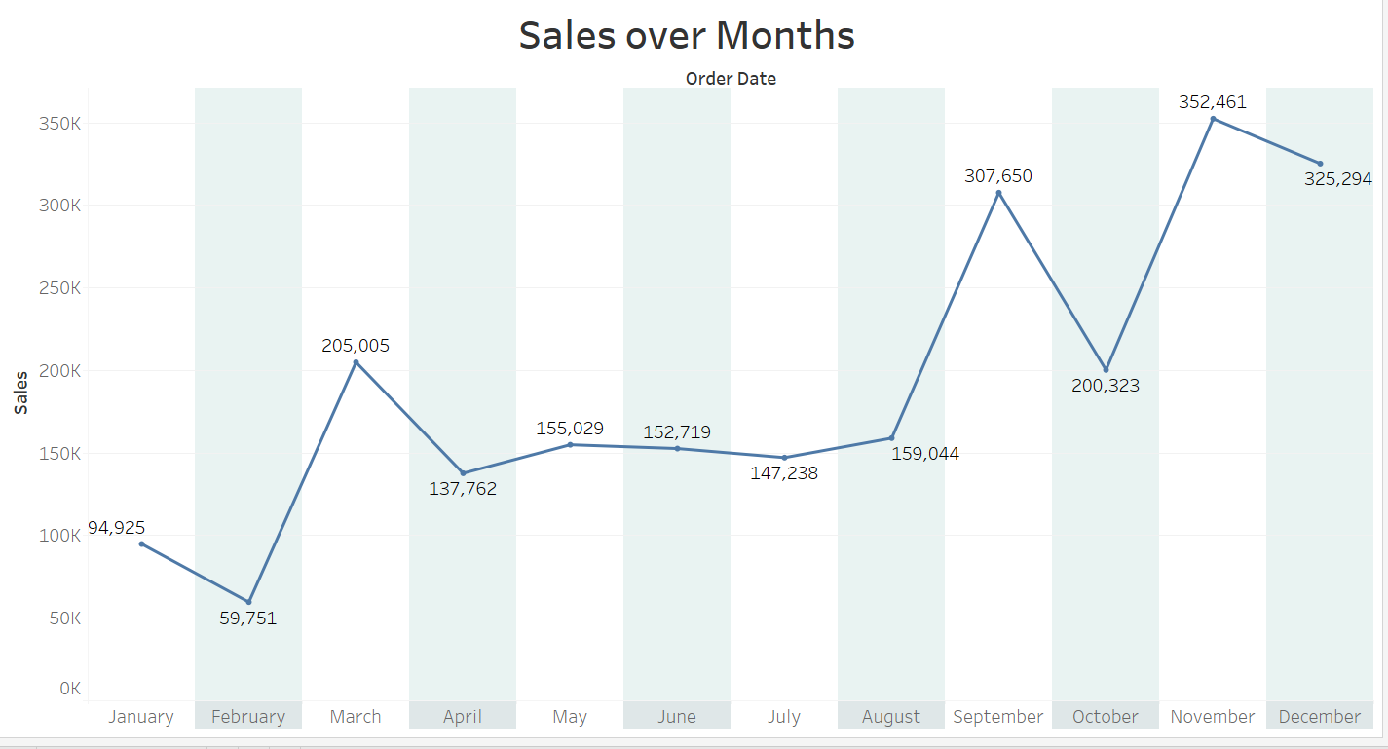
Line Chart: Sales over Months
Lowest sales: February (₹59,751)
Highest sales: November (₹352,461)
Notable spikes: March, September, and November
Sales dipped: After March and September
Consistent rise: From August to November

Slide 3
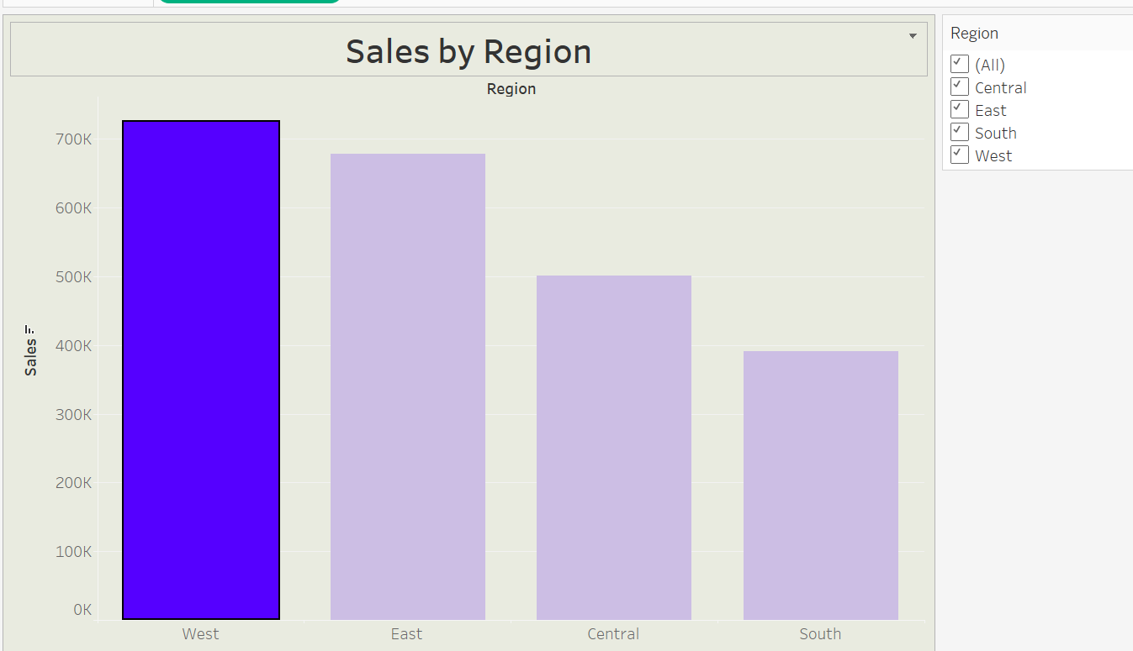
Bar Chart: Sales by Region
West region had the highest sales.
East region had the Second Highest sales.
Central region had the Third Highest sales.
South region had the Less sales.

Slide 4
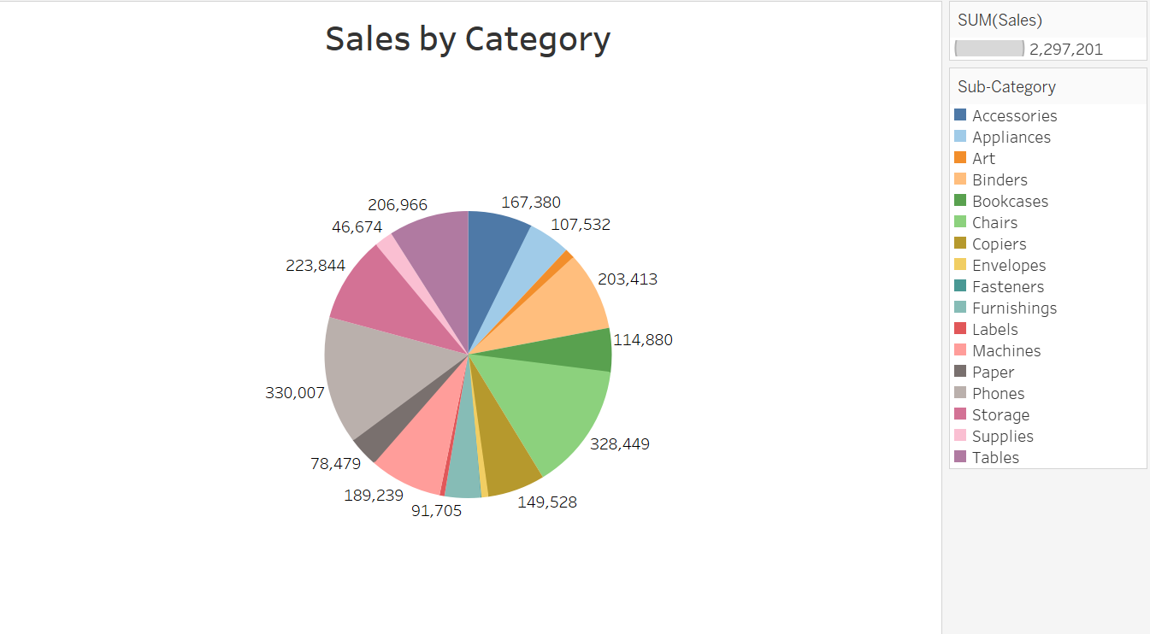
Donut Chart: Sales by Category
Here is the Sales by Sub-Category (Top to Bottom) in short:
Phones – 330,007
Chairs – 328,449
Storage – 223,844
Tables – 206,966
Binders – 203,413
Accessories – 167,380
Labels – 189,239
Copiers – 149,528
Bookcases – 114,880
Appliances – 107,532
Furnishings – 91,705
Paper – 78,479
Art – 46,674
Fasteners – 50,000 (approx)
Envelopes – 48,000 (approx)
Supplies – 46,674
Machines – (Value not clearly visible)
Conclusion: Phones and Chairs are top-performing sub-categories in sales.

Slide 5
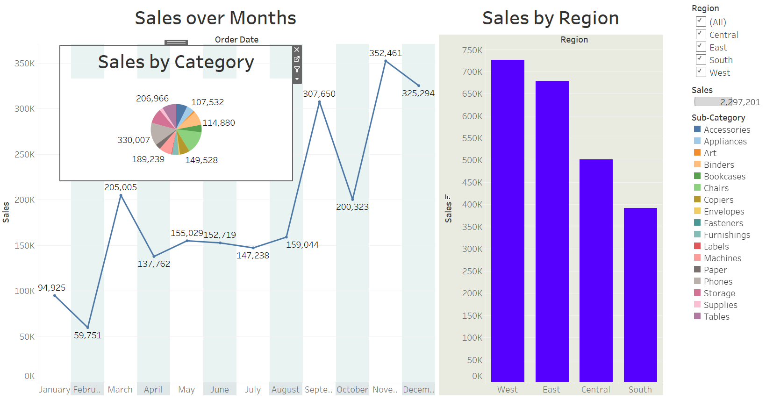
Sales Dashboard

